Slide 1
FILE SYSTEM
A file system is a method of organizing and retrieving files from a storage medium, such as a hard drive.
Without file system, all files would have no organization and it would be impossible for a file with the same name to exist.
Here, files are managed in a hierarchy, which allows you to view files in the current directory and then navigate into any subdirectories.

Slide 2
FILES AND DIRECTORIES
1. File :
A file is an object on a computer that stores data, information, settings, or commands used with a computer program.
2. Directories:
A directory is a location for storing files on your computer. Directories are found in a hierarchical file system, such as Linux, MS-DOS, OS/2, and Unix.
File systems usually consist of files separated into groups called directories.

Slide 3
FILE ATTRIBUTES AND OPERATIONS
Attribute | Bit Value
Read-Only (R) | 00000001
Hidden (H) | 00000010
System (S) | 00000100
Directory (D) | 00010000
Archive (A) | 00100000
Not Content Indexed (I) | 10000000000000
OPERATIONS
Create
Copy
Move
Rename
Delete

Slide 4
Types of file systems
Disk file systems
A disk file system takes advantages of the ability of disk storage media to randomly address data in a short amount of time.
2. Optical discs

Slide 5
WINDOWS FILE SYSTEM
File Allocation Table (FAT) :
A file allocation table (FAT) is a table that an operating system maintains on a hard disk that provides a map of the clusters (the basic units of logical storage on a hard disk) that a file has been stored in.
New Technology File System(NTFS) :
The New Technology File System (NTFS) is the standard file structure for the Windows NT operating system. It is used for retrieving and storing files on the hard disk.
Resilient File System(ReFS):
The Resilient File System (ReFS) is Microsoft's newest file system, designed to maximize data availability, scale efficiently to large data sets across diverse workloads, and provide data integrity by means of resiliency to corruption.

Slide 6
File Allocation Table (FAT)
FAT12 (12-bit File Allocation Table)
FAT16 (16-bit File Allocation Table)
FAT32 (32-bit File Allocation Table)
exFAT (Extended File Allocation Table)

Slide 7
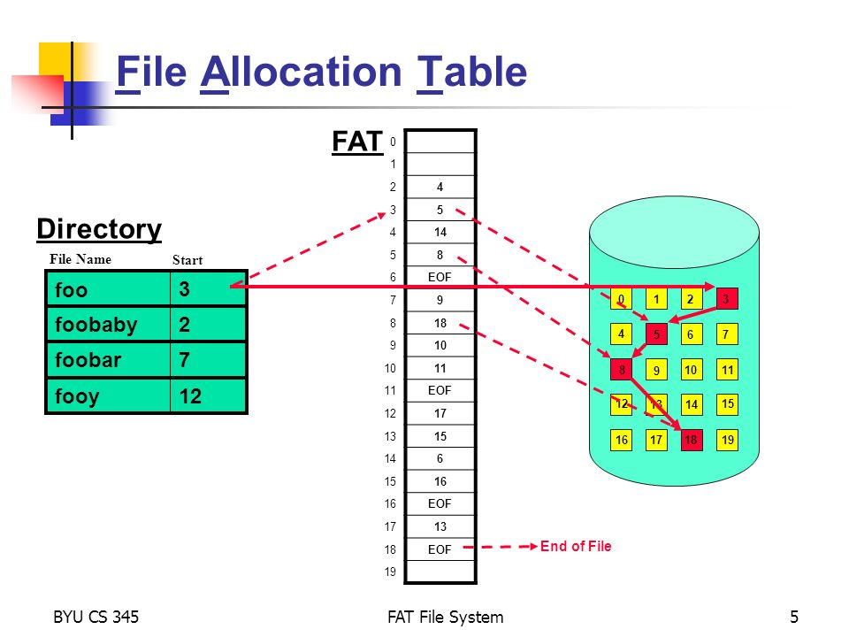
Disk Structure

Slide 8
FAT Naming Convention:
FAT uses the traditional 8.3 file naming convention and all filenames must be created with the ASCII character set.
The name of a file or directory can be up to eight characters long, then a period (.) separator, and up to a three character extension.
The name must start with either a letter or number and can contain any characters except for the following: . “ / \ [ ] : ; | = ,

Slide 9
ADVANTAGE & DISADVANTAGE

Slide 10
NEW TECHNOLOGY FILE SYSTEM
TFS v1.0- Microsoft introduced the first version of new technology file system with the release of Windows NT 3.1 in 1993.
NTFS v1.2- The second release of NT File System was with Windows NT 3.51 which provided features like compression, and access control list.
NTFS v3.0- Windows 2000came up with the third release of NTFS that brought many new features like disk quotas, Encrypting File System, reparse points, sparse files, update sequence number (USN) journaling etc.
NTFS v3.1- The fourth edition of NTFS was released with Windows XP, the main motive behind releasing this version was making redundant MFT (master file table) entries so that damaged MFT files can be recovered.

Slide 11
Features of NTFS
TFS file system provides many notable features like in order to improve performance NTFS uses b-tree data structure to keep record of file clusters. Main features of NTFS are listed below.
Self-healing NTFS- NT file system provides self-healing feature which detects and repair corruption on the NTFS volume or files at one fell swoop without having to run any disk repair utility.
ACL (Access Control List)- With NTFS, administrator can now set permissions using access control lists (ACL) which determines who else can access or modify a specific file.
File-Level Encryption- One of the noticeable feature of NTFS file system is file level encryption which protect your file content from unauthorized access.
Disk Quotas- The main feature of NTFS v3 is Disk Quotas which enables administrator to limit the disk space that a user may use. It also keep track of how much disk space is being used by each user. If a user cross the limit that has specified by administrator then he cannot store new data on a volume.
Reliable File System- NTFS File System automatically performs recovery operation, if system got shut down unexpectedly then NT file system checks for consistency by using transaction log and journal file.
File Compression- NTFS file system provides a new remarkable feature i.e. file compression. This feature allows user to compress large files so that disk space will be used efficiently.

Slide 12
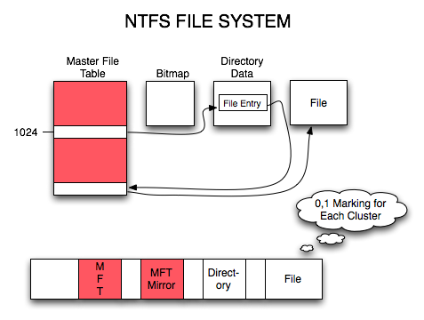
Disk Structure

Slide 13
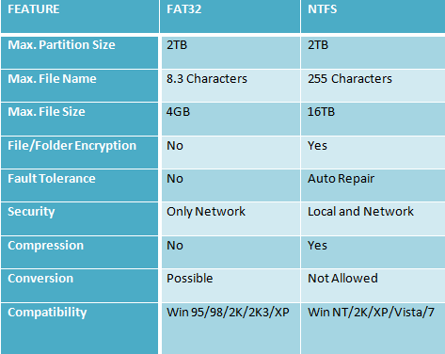
COMPARISON BETWEEN NTFS & FAT

Slide 14
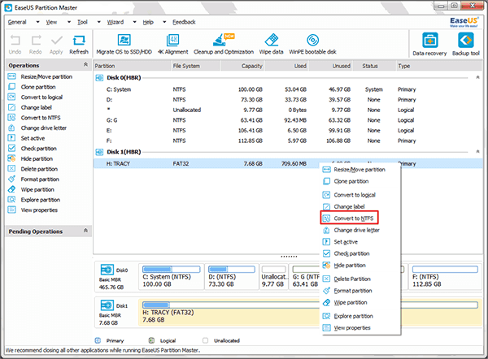
Converting FAT to NTFS
1. Select a FAT12/16/32 partition.
2. Right-click the partition and select Convert to NTFS.
3. The pop-up dialog box will show the source and destination file system, click "OK" to continue.

Slide 15
Some tips on converting FAT to NTFS with EaseUS Partition Master.
1. Partition conversion can only be realized under Windows. Linux is not supported.
2. This feature is only applicable for converting FAT to NTFS partition.
3. Source file system must be FAT12, FAT16 or FAT32 and the partition is unhidden.
4. Make sure there is minimum 3% free space on partitions.
5. The partition works well and can be recognized by EaseUS Partition Master.
6. This function is not available for EaseUS Partition Master bootable CD.
Apart from converting FAT to NTFS, EaseUS Partition Master also allows users to resize and move partition, copy partition, copy disk, explore partition, etc.
Conclusion:
No matter whether you convert FAT to NTFS using Convert.exe or EaseUS Partition Master, it is always a good idea to back up your data before you convert.

